Slide 1

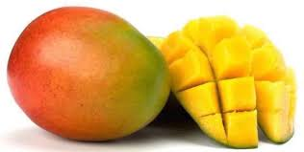


Dried fruits & Vegetables
AZURI HEALTH LTD
Social Enterprise Unlocking Markets for Farmers in Kenya
Interpack Dusseldorf
May 2017

Slide 2
Outline
1
Facts about Farming and Mangoes in Kenya
2
About Azuri Health
3
Value Chain

Slide 3
Facts
61% of the world’s potentially available cropland is in Sub-Saharan Africa.
Available cropland in 2013
in millions of hectares
8%
Rest of the world
61%
2013
31%
Source: Harvard Business Review (2013), africon GmbH (2017)
Africa
Latin America

Slide 4
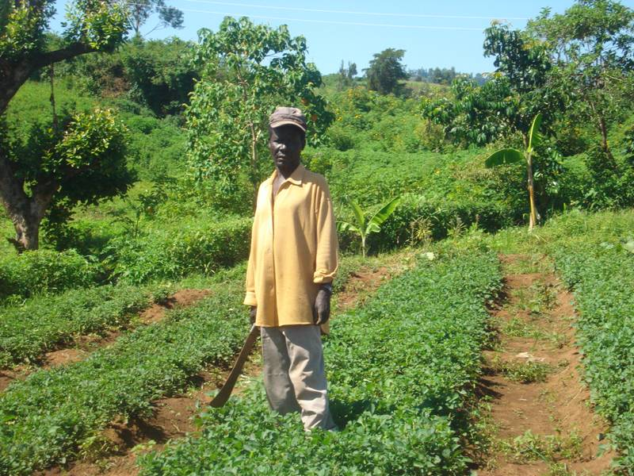
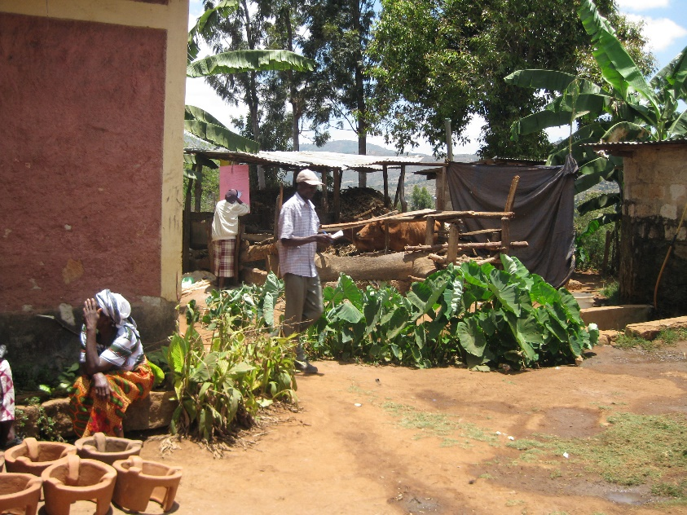
Facts
80% of farmland in sub Saharan Africa and Asia is managed by small holders
Out of the 2.5 billion people living in poverty, 1.5 billion people live in smallholder households

Slide 5
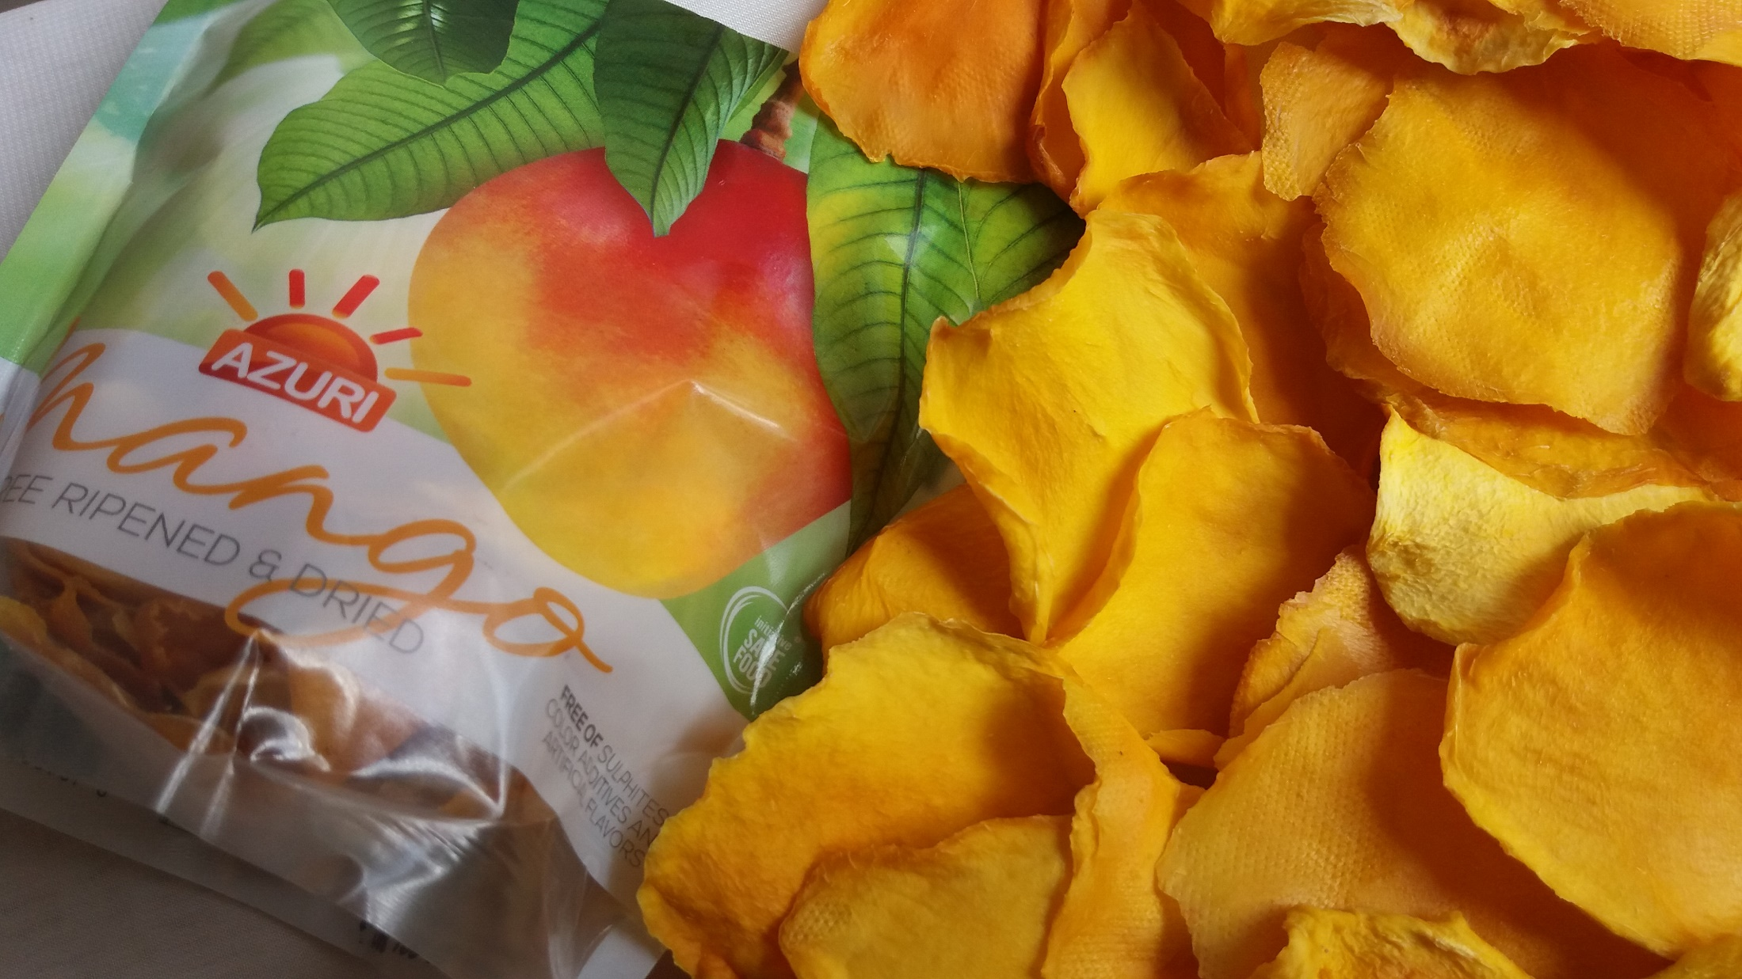
MANGO

Slide 6


Mango production worldwide
India is the biggest producer of mangos worldwide…
Production of mangos
(thousand MT in 2010)
Source: Kenya Investment Authority (2012) (africon GmbH)

Slide 7
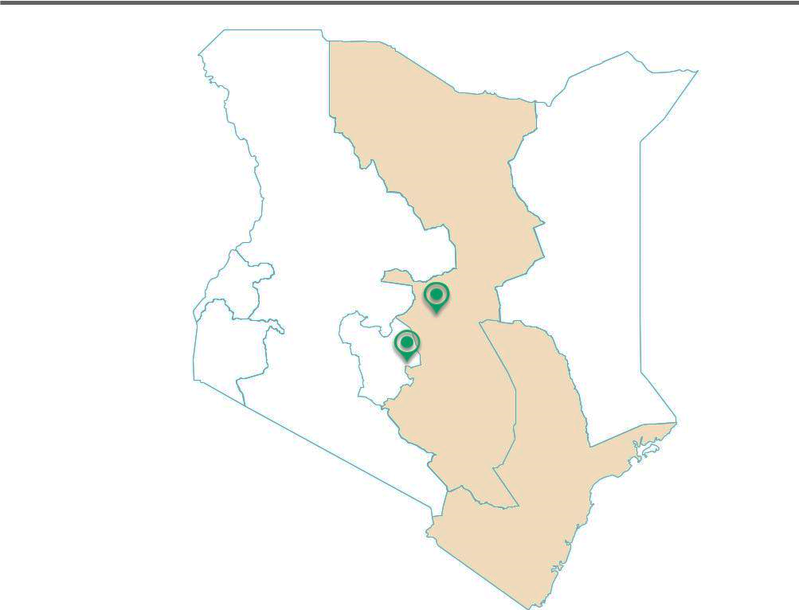


Mangoes are mainly grown in Eastern and Coast regions; majority of produce is sold fresh with farmers incurring high post harvest losses
Main Mango production areas (79% of total)
Azuri Mango farmers
Azuri Works with farmers in Key mango zones

Slide 8
Challenge
Approximately 36% of all mangos in Kenya are lost every year.
Production of mangos by small scale farmer
(MT of mangos, 2014)
36 %
Source: Kenya Investment Authority (2012) africon GmbH

Slide 9
Reasons for mango food loss
Almost 45% of all mango food loss can be tackled within the SAVE FOOD initiative championed in Kenya by Azuri Health
45%
Source: Kenya Investment Authority (2012) africon GmbH

Slide 10
1
Facts about Farming and Mangoes in Kenya
About Azuri Health
2
About Azuri Health
2
3
Value Chain

Slide 11
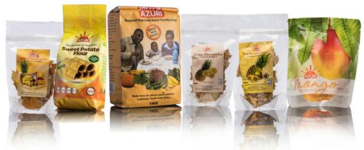
Introducing Azuri
Azuri’s Vision is to become the tastiest, healthiest and most innovative fruit and vegetable processing company in Africa.

Slide 12
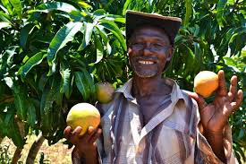
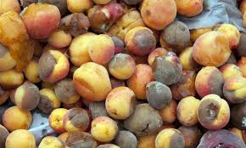
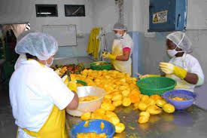

Azuri’s Social Footprint & Impact
Currently income generation for over 400 farmers supplying produce to Azuri
Reduction in Post Harvest Losses in Horticulture
Jobs for women and youth across the value chain generated by developing and selling of Azuri products
Better health to the consumers in a variety of product choices

Slide 13
Azuri’s scaling plans are to grow the farmer network, increase processing capacity, develop new products, & enter new markets

Slide 14
Azuri’s Strategy Themes: 2017 - 2022
2022
2020
Enhance our production capacity to 50 tonnes per month
Open export markets in Asia and Middle East: Dubai & Japan
New product launch: mango leather
Hit 300,000 MT of mangoes
2018
Consolidation of gains
Employee ownership plan
Listing on stock exchange
Setup regional subsidiaries
Enhance exports to Europe and America
Form partnerships and joint ventures for global operations
Setup more drying hubs in Kenya
2017

Slide 15
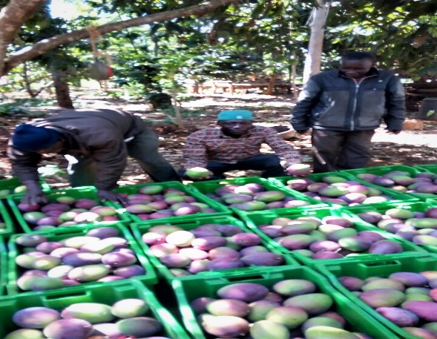
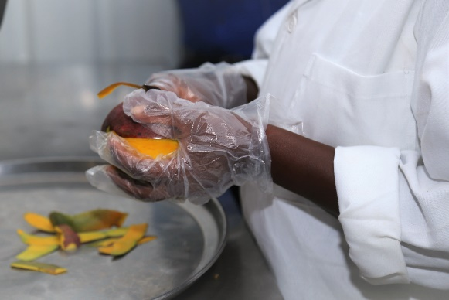
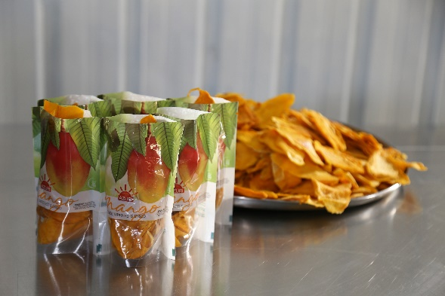
Azuri’s Value Chain
Contract Farmer
Raw Materials
Processing Hubs
International Markets
Azuri sources produce directly from farmer groups trained & consolidated with the help of Technoserve.
Azuri converts 30MT per week in each HUB of fresh mangoes into dried mangoes and stores ready for dispatch
Azuri offers delectable dried fruits to markets meeting their quality and quantity standards

Slide 16
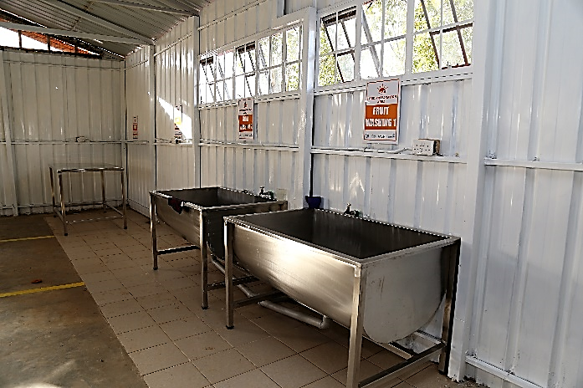
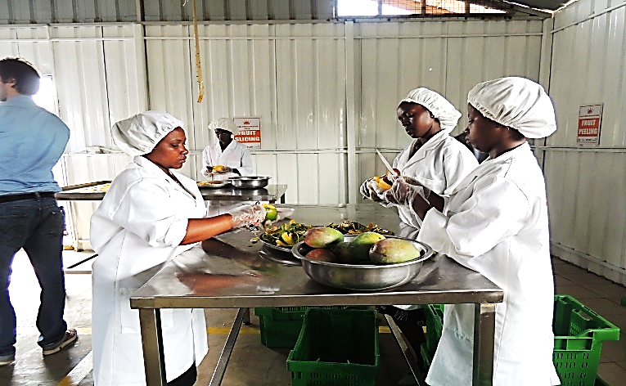
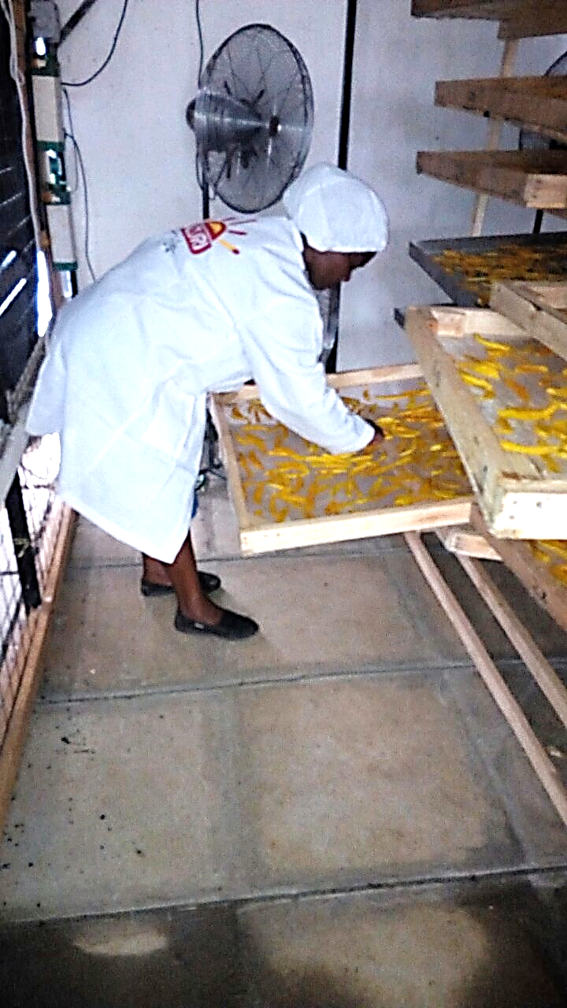
Azuri’s Process
At the Save Foods Hub in Thika the Mangoes are Washed
Peeled and sliced
Then Dried in a Biogas/Solar/LPG dryer

Slide 17
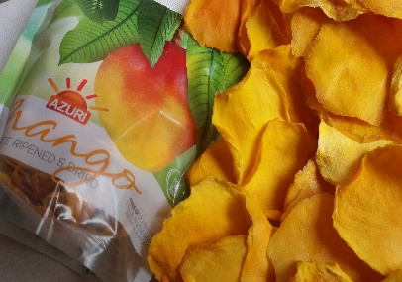
Azuri’s Process
Methodical processing of Mango maintains hygiene and ensures high quality of end product
Source: Open Capital (2016)

Slide 18
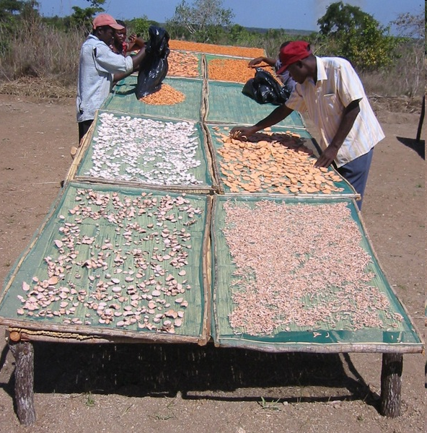
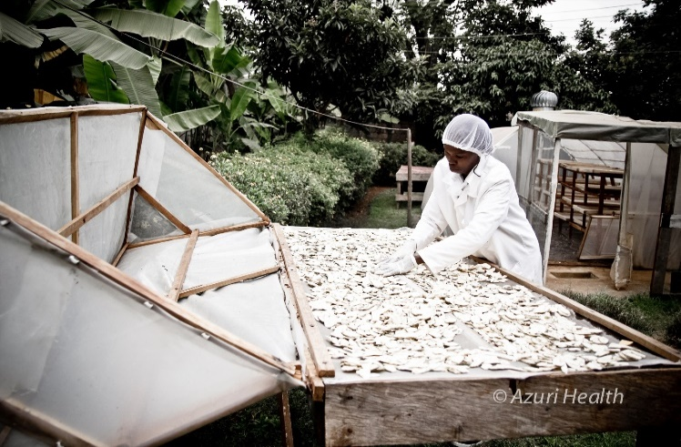
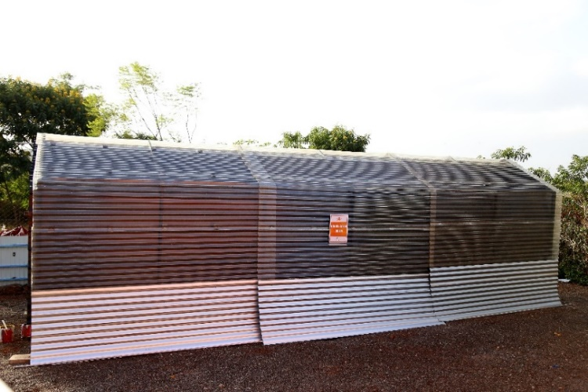
Azuri’s Process – Drying is Core
Continuous improvement on quality of drying using Solar dryers
Solar/Biogas/LPG 24hr dryer
Transitioning from traditional sun drying done by farmers

Slide 19








Azuri’s Partners
Our partners enable us to leverage the value chain from farmer produce aggregation, quality processing and scale, product development and access to market
.

Slide 20
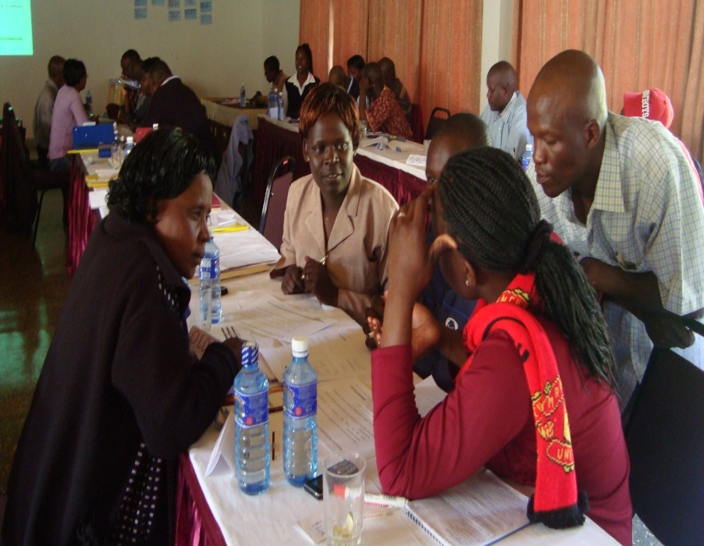
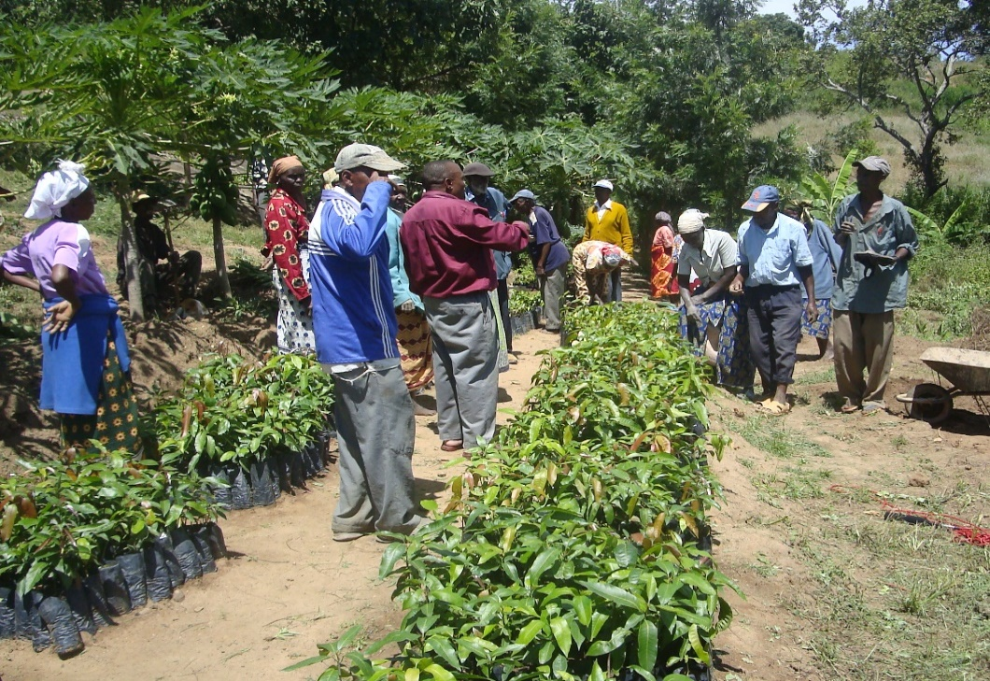
Farmer Backward Integration
Training on Quality Standards and good business management to achieve Global Gap certification
Good Farming Practices and correct planting varieties

Slide 21
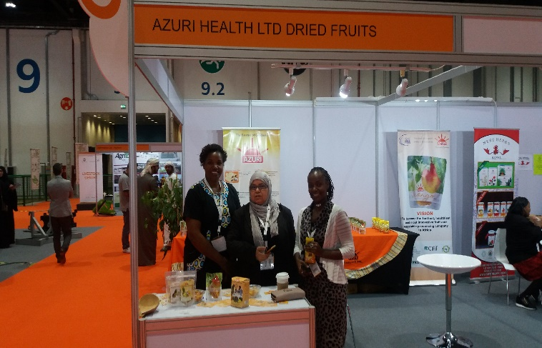
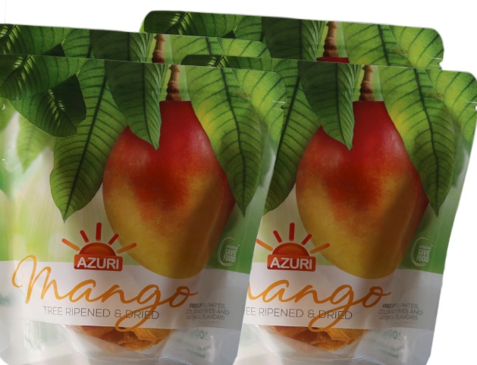
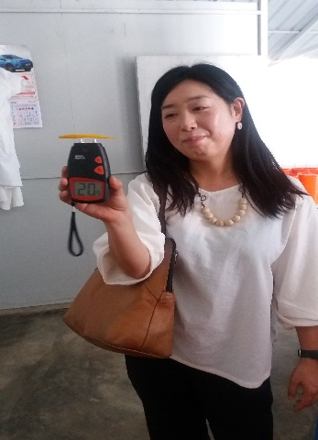
Market Forward Integration
Potential markets : Japan, Germany, Switzerland, Netherlands, UK, USA, Greece, Middle East, South Africa, Uganda, Rwanda
Market opportunities through international Trade Fairs and Exhibitions
Buyers placing orders and followup checks on progress
Packaged to international standards thanks to WIPF

Slide 22
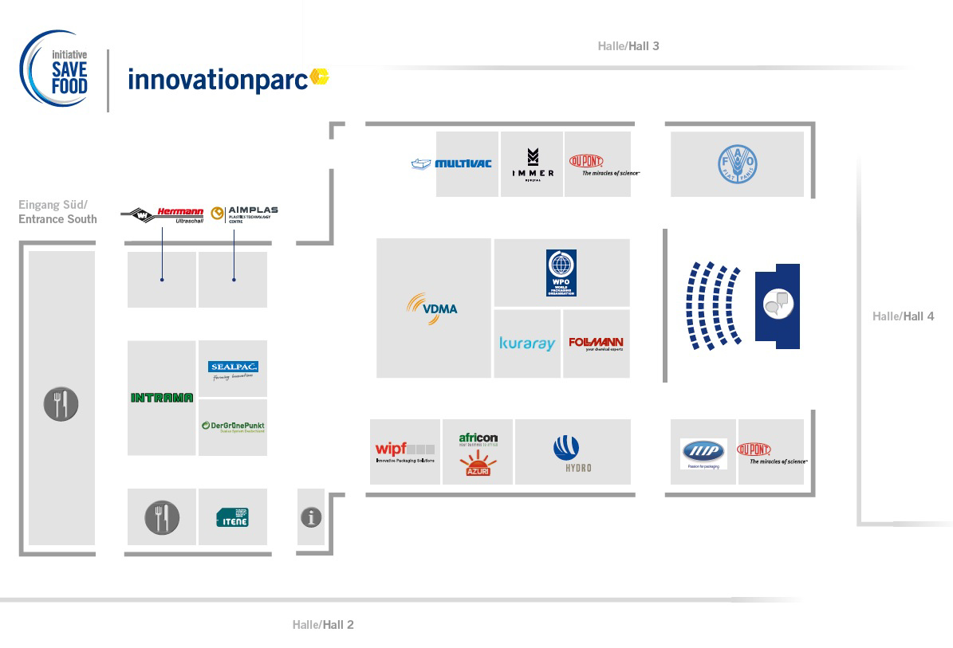
Come and visit us:
INNOVATIONPARC

Slide 23
ASANTE SANA

